Slide 2

The best insider threat program to exist on this earth
Notes:
Words: "Hello everyone, we're here to present to you the best insider threat program ever created. But first, let's introduce you to the team. (Next Slide)

Slide 3






Dream Team
Kristy Li
Cyber Threat Analyst
Melissa Chan
Behavior Analyst
Abdoul Barry
IT Risk Analyst
Harrison Fernandez Cyber Threat Analyst
Randy Rosario Behavioral Analyst
Mutasem Sayeedi
Compliance Analyst
Notes:
"Here's our team, we have Mutasem - our compliance analyst, Barry – our IT risk analyst (the second line of defense)
Melissa and Randy – our behavioral analysts, finally, Kristy and myself (Harrison) – our Cyber Threat Analysts (first line of defense)"

Slide 4
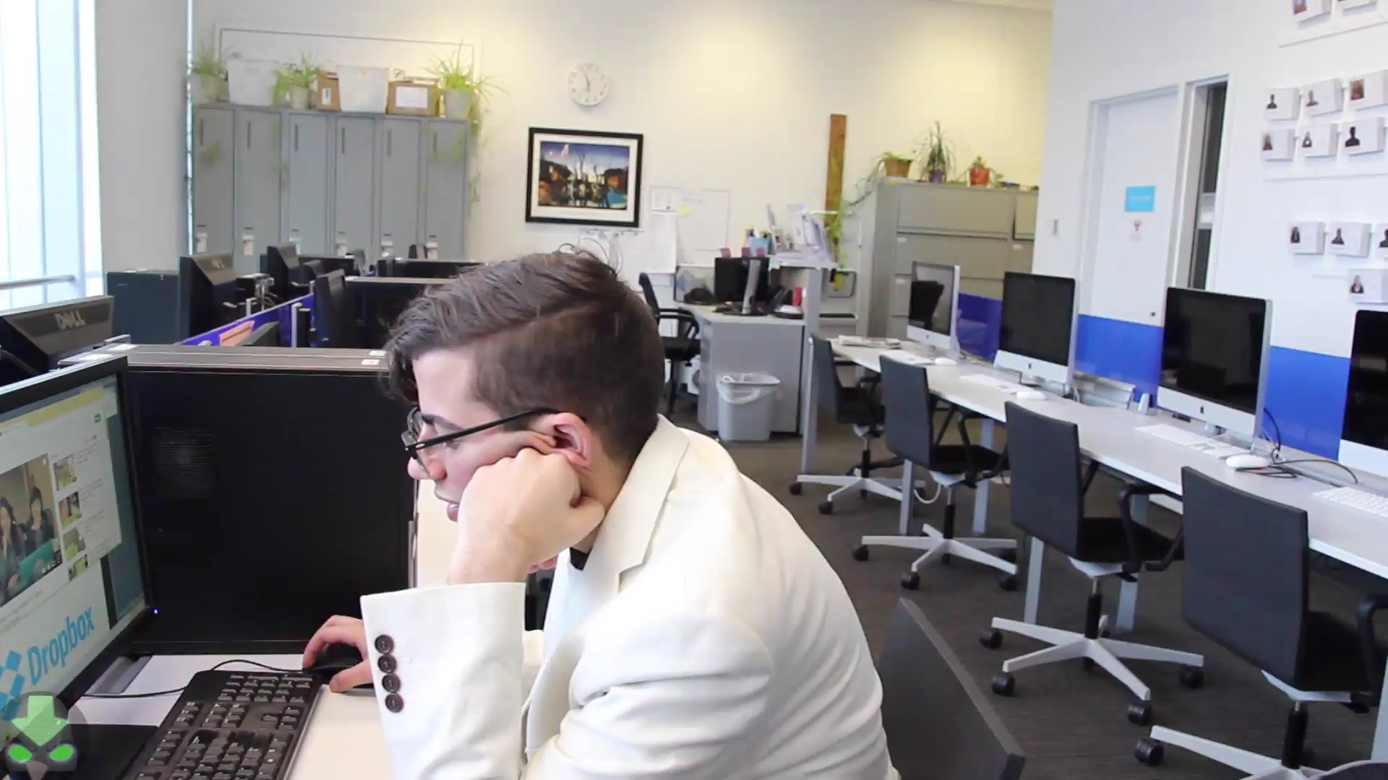
Just a normal Day at Gnb..

Slide 5



So, what did we just see?
Greed
Espionage
Disgruntlement
Notes:
**Animate pics to appear at different times**
Who – Randy – Senior Management
What – Espionage & threat to national security
When – January 21, 2016
Where – Goliath National Bank
Why – Greed: Personal Debts
– Disgruntlement: Revenge at the company & boss who fired him
How – Spy had unnecessary access to privileged information, nobody is there to double check his actions, not enough HR policies, and no restrictions on removable data

Slide 6


Inherent Risk
Fire Employees?
Improve Preventative Measures
Block Websites
Role Based Access Control
Notes:
Risk assessment – who is an insider? - It can be ANYONE
Green, Yellow, Red Bar – Arrow animated to look like it goes from green to red = show that it is high
Residual risk – bar arrow go from red to green = show how it went from high to low.

Slide 7
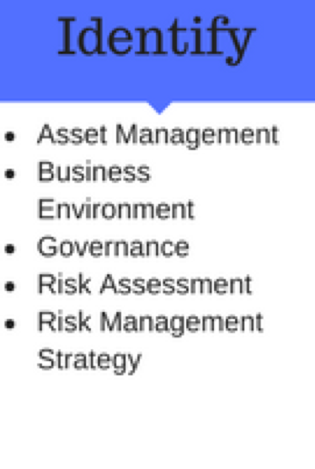
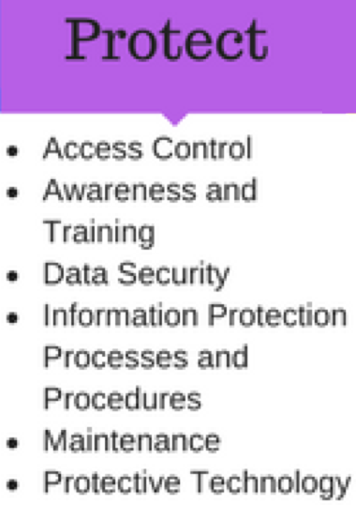
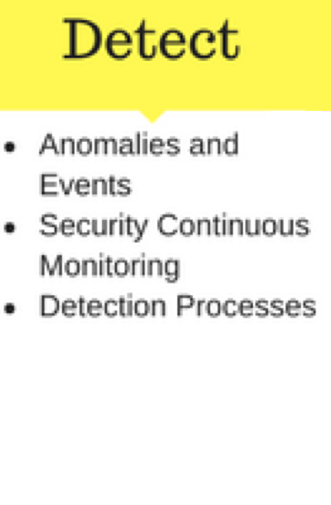
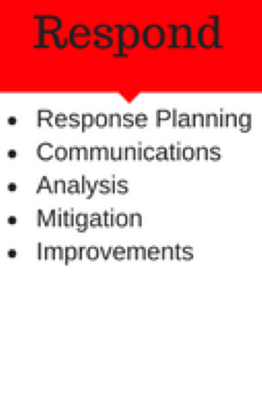
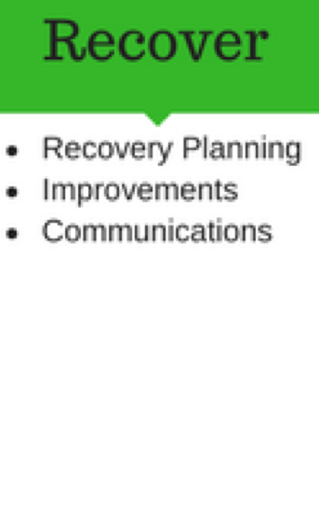
How is the program utilized?
Notes:
The NIST Framework serves as a way to assist GNB in managing cybersecurity risk. The integration of the NIST Framework
is essential because it takes into account organizational priorities and goals, standards, guidelines, and practices.

Slide 8





Best practices
Notes:
GNB must have measures and controls instated to prevent malicious and inadvertent insider threats. The biggest security risk is associated with employees. Some essential measures and controls to prevent and mitigate are the following:
- Continuous background checks and screening before and after hiring.
- Up-to-date software, anti-virus, and system logs.
- Employees should be constantly monitored.
- Implement SIEM (Security Incident and Event Manager) and an IDS (Intrusion Detection System) to detect unusual, suspicious activities and behavior.
- Develop an environment where employees can report suspicious behavior without fear of reprisal.
- Have GNB’s firewall strictly limit access to GNB's network.

Slide 9



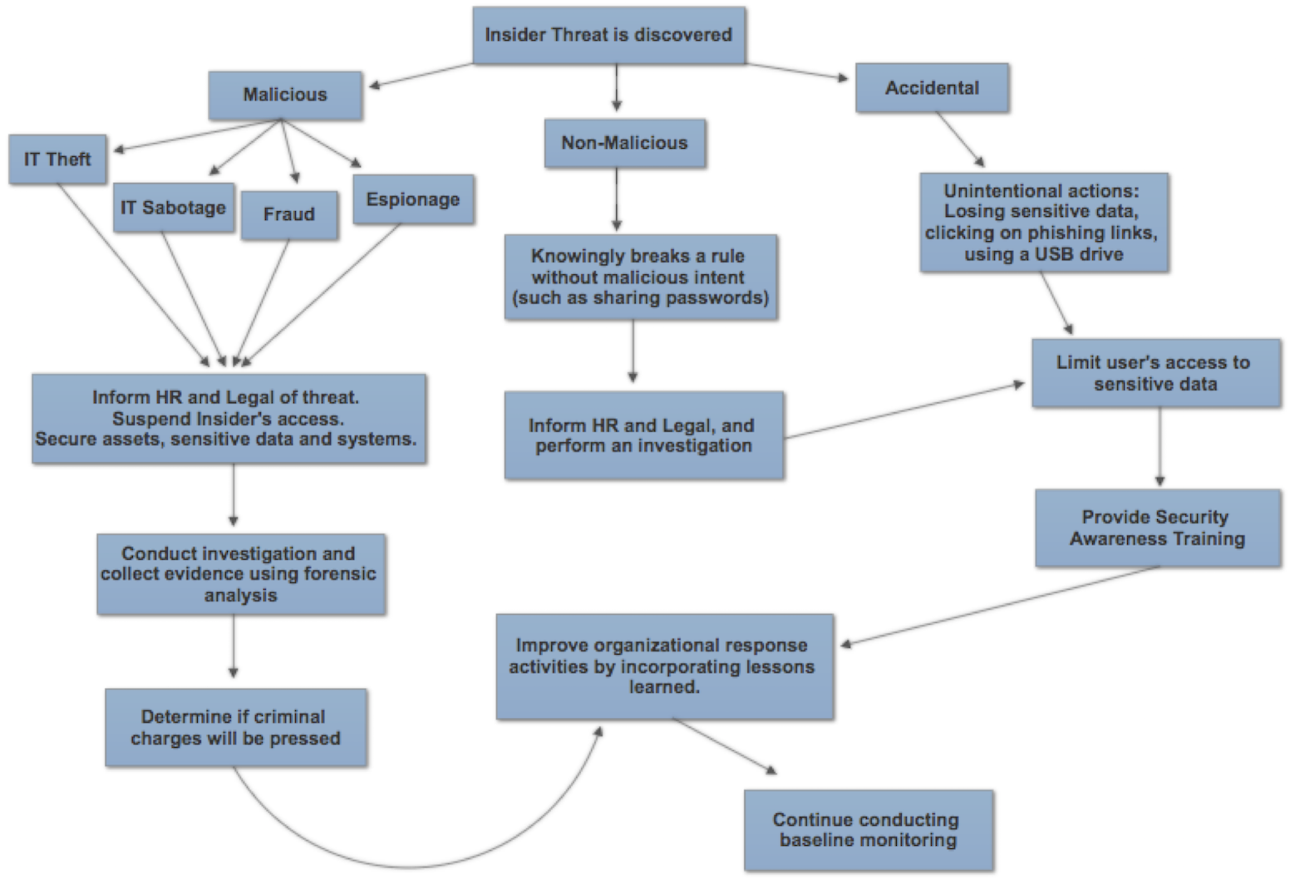

Response
Notes:
The way in which GNB responds to a cybersecurity event is essential. By responding to the incident in a timely manner, further escalation and detrimental consequences can be avoided. GNB should implement
- Policies and procedures to follow up on the incident after it is discovered
- Tools in email apps to allow employees to flag suspect emails
- Setting up dedicated team and Chief Security Officers is also a trend on the rise

Slide 10



Recover
Notes:
Pictures will be animated in order
Computer( Isolate)
Involve
Develop (Harrison on legit GNB Podium)
Color: GREEN
The recover function is essential in order for GNB to continue functioning if a cybersecurity incident occurred.
GNB must have a recovery plan that...
Isolate any systems compromised to prevent potential damage to other systems.
Involve independent auditors in the evaluation process of security and monitoring systems as a way to identify weaknesses and improvements that can be implemented.
Develop GNB’s public response to the cybersecurity event with the input of internal and external PR personnel.
We worked with GNB to create a press release to restore the confidence of the bank in the stakeholders and customers.
Develop the company's public response to the cybersecurity event with a press release to restore the confidence of the bank in the stakeholders and customers

Slide 11


Residual Risk
Notes:
Don’t delete any of the arrows. **Click twice really fast.**
All risk cannot be eradicated 100% as the cybersecurity landscape is always changing.
So it is important that companies stay up-to-date on new threats and update their response plan.
So it's important for companies to be aware that human error may occur to prevent proper mitigation of incident. So proper training should be given to prevent this and the company should be prepared to document and respond effectively and efficiently to both the error and the attack.

Slide 12
Lesson Learned
Organizations must have a holistic approach to security.
Use layered security to maximize the protection.
Stay vigilant.
Keep up with the latest trends in cybersecurity.
Notes:
I think this can pop up all at once.

Slide 13




Thank you!
Special thanks to Office of Strategic Initiatives, Frank Cicio, Robert Hamilton, Robert Francis, Roseanna Blum, and our awesome mentors Joel Ruffin and Carraig Stanwyck!

